Slide 1
Smart Home Automation System
Web-Based IoT Control System
Presented by: Dhanshree Kamble PCCOE
b.Voc iot

Slide 2
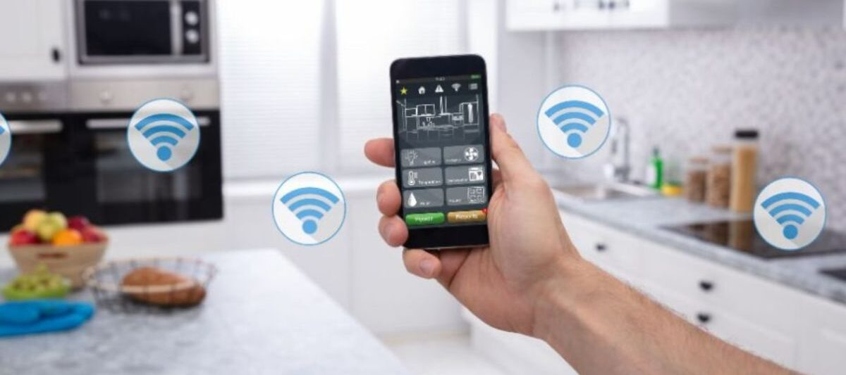
Introduction
A smart home system allows remote control of appliances via the web.
Built using ESP8266 microcontrollers and relay modules.
Control rooms: Hall, Bedroom, Kitchen.
Responsive web dashboard with light/dark mode.

Slide 3
Technologies Used
Hardware: ESP8266, Relay Modules
Languages: JavaScript, HTML, CSS
Frameworks: Node.js, Express.js, EJS, Tailwind CSS
Database: MongoDB
Protocol: MQTT

Slide 4
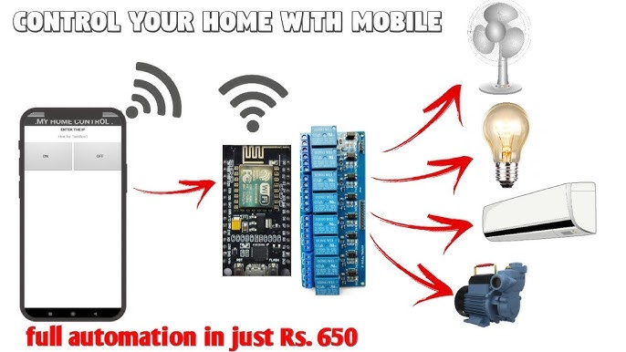
WORK FLOW

Slide 5
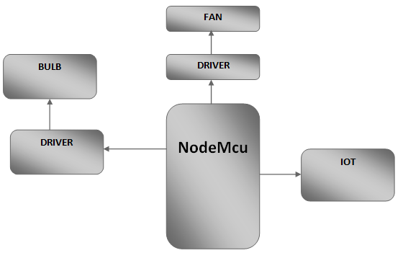
BLOCK DIAGRAM

Slide 6
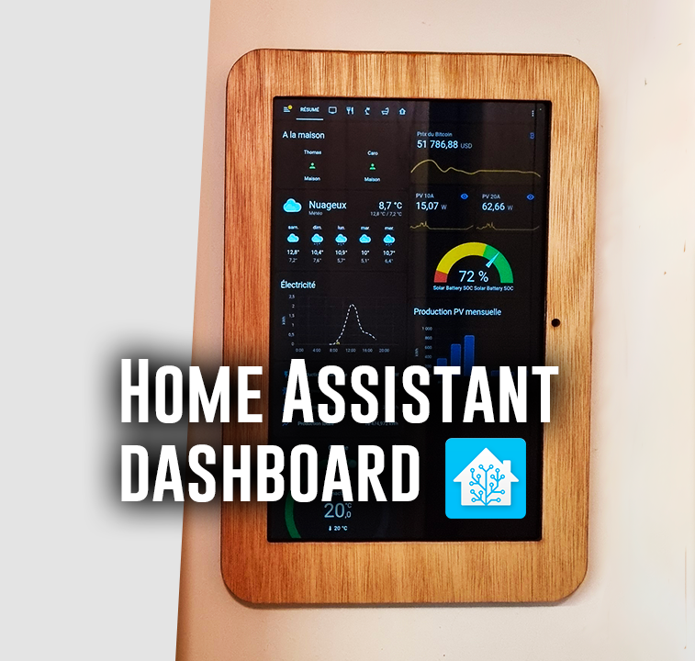
Dashboard Interface
Toggle switches for each appliance
Rooms grouped: Hall, Bedroom, Kitchen
Light/Dark mode support
Real-time status feedback
This Photo by Unknown Author is licensed under CC BY

Slide 7
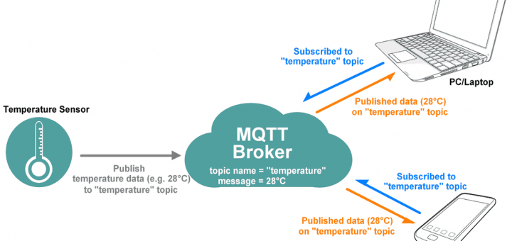
MQTT Communication Flow
User Action: Toggle switch
Server: Publishes to user-specific MQTT topic
ESP8266: Subscribes to topic, activates relay
Feedback: Publishes status update back to dashboard

Slide 8
Security Measures
User authentication (login/logout)
Session management (stay logged in)
MQTT topics scoped per user
Input validation on frontend/backend

Slide 9
#include <WiFi.h>
#include <PubSubClient.h>
const char* ssid = "vivo”;
const char* password = "123456789”;
const char* mqtt_server = "dev.coppercloud.in";
WiFiClient espClient;
PubSubClient client(espClient);
const char* user_email = "dhanshreekamble094@gmail.com";
String topic = String(user_email) + "/IOT";
#define LED1_PIN 5
void setup() {
Serial.begin(115200);
pinMode(LED1_PIN, OUTPUT);
digitalWrite(LED1_PIN, LOW);
Serial.print("Connecting to WiFi...");
WiFi.begin(ssid, password);
while (WiFi.status() != WL_CONNECTED) {
delay(500);
Serial.print(".");
}

Slide 10
Serial.println("\n✅ WiFi Connected!");
// Set MQTT server
client.setServer(mqtt_server, 1883);
client.setCallback(callback);
reconnect(); // Connect to MQTT
}
void callback(char* topic, byte* payload, unsigned int length) {
Serial.print("\n📩 Message received on topic: ");
Serial.println(topic);
String message;
for (int i = 0; i < length; i++) {
message += (char)payload[i];
}
message.trim(); // Remove extra spaces/newlines
Serial.print("✅ Processed Message: ");
Serial.println(message);
if (message == "bedroom1off") {
digitalWrite(LED1_PIN, HIGH);
Serial.println("✅ LED 1 ON");
} else if (message == "bedroom1on") {
digitalWrite(LED1_PIN, LOW);
Serial.println("✅ LED 1 OFF");
}

Slide 11
void reconnect() {
while (!client.connected()) {
Serial.print("Connecting to MQTT...");
if (client.connect("ESP32Client")) {
Serial.println("✅ Connected!");
client.subscribe(topic.c_str()); // Subscribe to user-specific topic
Serial.print("📡 Subscribed to: ");
Serial.println(topic);
} else {
Serial.print("❌ Failed, rc=");
Serial.print(client.state());
Serial.println(" retrying in 5 seconds...");
delay(5000);
}
}
}
void loop() {
if (!client.connected()) {
reconnect();
}
client.loop();
}

Slide 12
Future Scope
Voice control (Alexa/Google Assistant)
Energy usage monitoring
Scheduling & automation
Mobile app version
Integration with AI for smart behavior
Remote access via cloud

Slide 13
Conclusion
Seamless integration of software and hardware
Real-time, secure, and user-friendly control
Scalable and extendable system
Great potential in smart living solutions

Slide 14

Questions

Slide 15

Thank You

